Slide 1

PCG Signal Denoising Using Switched Adaptive Filtering Technique with low-Complexity (B145)
Project Member Details Swapnil Maiti (RA2111004010283)
Deekshitha Adusumalli (RA2111004010290) Sahil Sharma(RA2011004010252)
Kunal Keshan (RA2011004010051)
Project Guide Dr. S. Hannah Pauline

Slide 2
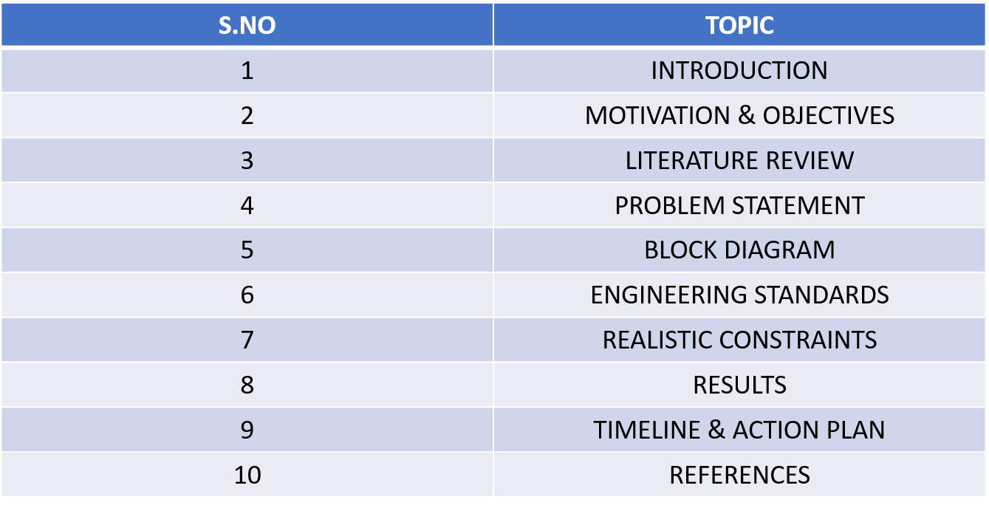
INDEX

Slide 3
INTRODUCTION
Phonocardiogram (PCG) signals are recordings of the sounds produced by the heart, typically captured using a stethoscope or a specialized microphone.
These signals provide critical information about the heart’s mechanical activity, such as the opening and closing of valves and blood flow dynamics and is used in diagnosing and monitoring heart conditions, including valve disorders and heart murmurs.
By analyzing the distinct sounds within the PCG—through digital signal processing techniques that examine the timing, frequency, and intensity of heart sounds—medical professionals can accurately identify and interpret cardiac events.

Slide 4
However, PCG signals are susceptible to noise from various sources, including environmental sounds, body movements, electronic interference, and respiratory noises.
This noise can significantly affect the accuracy and reliability of PCG analysis.
Interference can lead to misinterpretation of heart sounds, potentially resulting in misdiagnosis or overlooked conditions.
Therefore, implementing effective noise reduction techniques, such as filtering and adaptive noise cancellation, is essential to maintain the clarity and usability of PCG signals for precise cardiac assessments.

Slide 5
Motivation & Objectives of the work
Accurate Diagnosis: PCG signals are used to diagnose various heart conditions. Noise can obscure important features in these signals, leading to misdiagnosis or missed diagnosis.
Improved Signal Quality: Noise reduction enhances the clarity of the heart sounds, making it easier for clinicians and automated systems to analyze them.
Reliable Feature Extraction: Many diagnostic algorithms rely on extracting features from PCG signals. Noise can interfere with the accuracy of these features.
Automation: Automated systems for heart sound analysis require clean signals for robust performance. Noise can cause these systems to fail or produce unreliable results.

Slide 6
Objective
Objective: Develop an adaptive filter setup for effective noise cancellation, aiming for high signal-to-noise ratio (SNR) and minimal estimation error with a straightforward algorithm.
Proposed Solution: Introduce a multi-stage feed-forward switched adaptive filter model designed for active noise control (ANC) systems.
Novel Approach: The system automatically adjusts the number of filter stages to enhance performance.
Algorithm Innovation: Utilize switching between two signed LMS (Least Mean Squares) algorithms for each filter stage to optimize results.

Slide 7
Literature survey
YEAR AND PUBLICATION | TOPIC | INFERENCE
Published in 2023 in IEEE. | Hardware Co-Simulation of Adaptive Noise Cancellation System using LMS and Leaky LMS Algorithms | This paper discusses the co-simulation approach for implementing adaptive noise cancellation using LMS and Leaky LMS algorithms, showing improved noise cancellation efficiency when implemented in hardware setups like FPGA.
Published in 2022 in the International Journal of Electronics and Communications. | Implementation of Optimized Adaptive LMS Noise Cancellation System to Enhance Signal to Noise Ratio | The paper focuses on optimizing the LMS algorithm to improve the signal-to-noise ratio (SNR) in communication systems, demonstrating significant performance enhancements in various noise environments.
Published in 2021 in IEEE Transactions on Signal Processing. | Reconfigurable Filter Design for Multiband Noise Cancellation | This research introduces a reconfigurable filter design that can adapt to different noise bands, improving the versatility and effectiveness of noise cancellation systems in dynamic environments.
Published in 2022 in the Journal of Signal and Information Processing. | A Comparative Study on Characteristics and Properties of Adaptive Algorithms applied to Noise Cancellation Techniques | This study compares various adaptive algorithms like LMS, RLS, and NLMS, analyzing their strengths and weaknesses in noise cancellation applications, providing insights into selecting the most suitable algorithm for specific use cases.

Slide 8
YEAR AND PUBLICATION | TOPIC | INFERENCE
IEEE Transactions on Signal Processing | Performance Analysis of Adaptive Filters for Noise Cancellation in Various Environments | The paper discusses the performance of different adaptive filter algorithms in various noise environments, providing a comparative study on their effectiveness.
Multidimensional Systems and Signal Processing 33, 1387-1408 (2022). | A low-cost automatic switched adaptive filtering technique for denoising impaired speech signals. | The proposed adaptive filter model, which combines LMS and NLMS algorithms, effectively reduces noise in speech signals, particularly those affected by Parkinson's disease. This model outperforms existing filters by significantly improving SNR, MSE, and PSNR, offering a cost-effective solution for adaptive noise cancellation with high accuracy.

Slide 9
Problem Statement
Challenges with Traditional Adaptive Filters:
Difficulty achieving high Signal-to-Noise Ratio (SNR) with low estimation error.
Slow convergence rates.
Instability in performance.
Limitations of Existing Filters:
Fixed-stage filters are not adaptable to varying noise environments.
Performance is limited due to the inability to adjust filter stages dynamically.

Slide 10
Proposed Solution:
Development of a Multi-Stage Feed-Forward Adaptive Filter:
Automatic Adjustment of Filter Stages: The filter adjusts the number of stages automatically to optimize performance.
Algorithm Switching: It switches between two signed LMS algorithms to balance between noise reduction and convergence speed.
Aim of the Work:
To enhance the efficiency of noise cancellation.
To improve adaptability in diverse applications, making the filter suitable for varying noise environments.

Slide 11
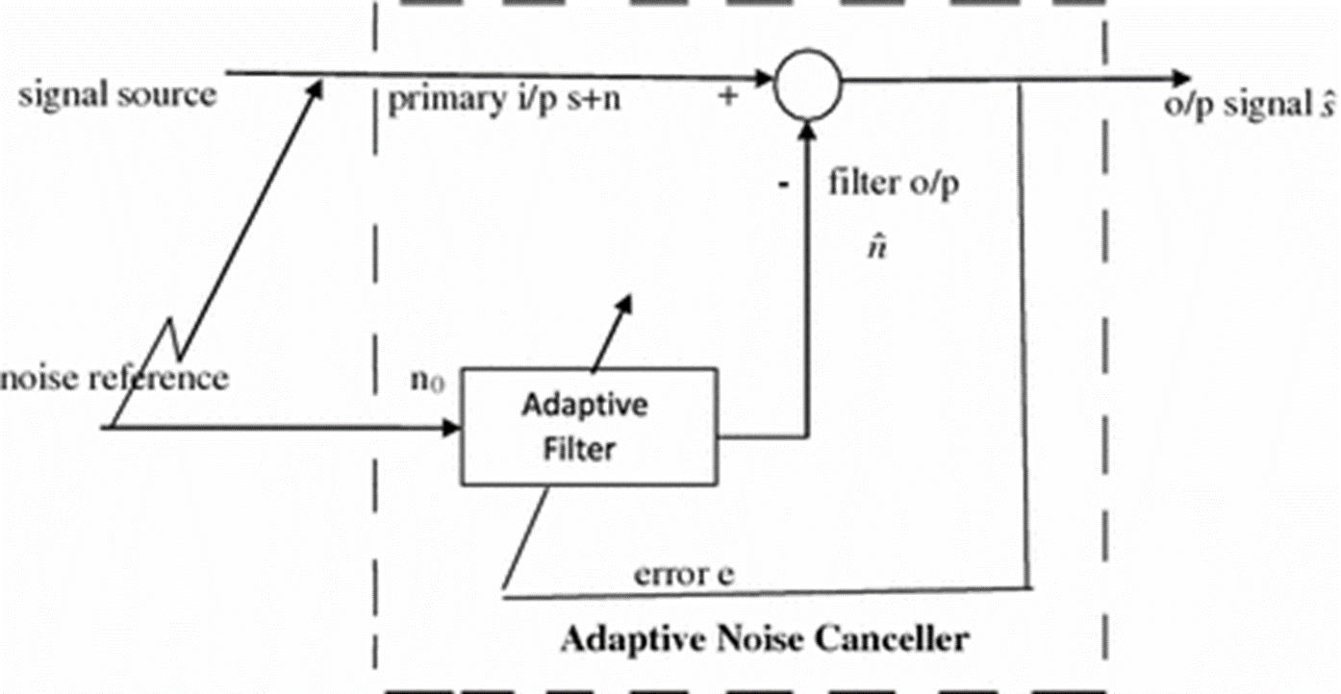
Block Diagram of Adaptive Filter

Slide 12
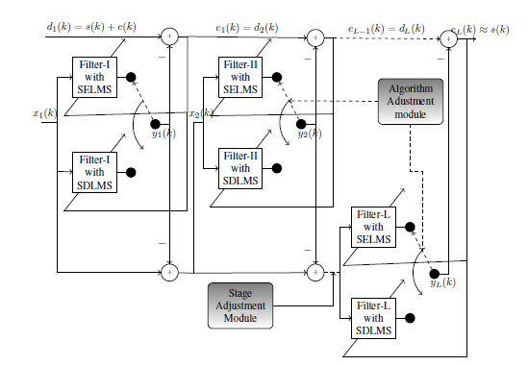

Slide 13
Proposed approach
For Stage I ANC, the initial input is d1(k)=s(k)+c(k)
and the reference input is the noise signal c′(k).
The erroneous signal from the previous ANC stage serves as the input for the current stage.
The noise from the previous ANC stage is used as the reference noise for the current stage.
The design incorporates feed-forward SDLMS and SELMS adaptive filters with filter coefficients updated using the Sign Data LMS algorithm.
Weights are adjusted based on the error from the previous stage and the difference between the output and input of the previous stage filter.

Slide 14
Stage addition is controlled automatically, based on the correlation between the output error of the current stage and the standard noise.
If the error is minimally correlated with c′(k), no additional stage is added.
The optimal condition is where there is no correlation between e(k) and c′(k), resulting in minimal noise in the final output.
The step size is adjusted according to the autocorrelation of the inbound signal.
Inputs at the final stage L are processed based on the described mechanism and adjustments made throughout the stages.

Slide 15
Realistic Constraints
Slow Convergence: Adaptive filters converge slowly if initial coefficients are far from optimal.
Step Size Sensitivity: Stability and convergence depend on the step size; too large can cause instability, too small results in slow convergence.
Input Signal Properties: The filter's performance is affected by input signal characteristics like autocorrelation and noise.
Trade-offs: A larger step size speeds up convergence but may cause instability; a smaller step size enhances stability but slows convergence.

Slide 16
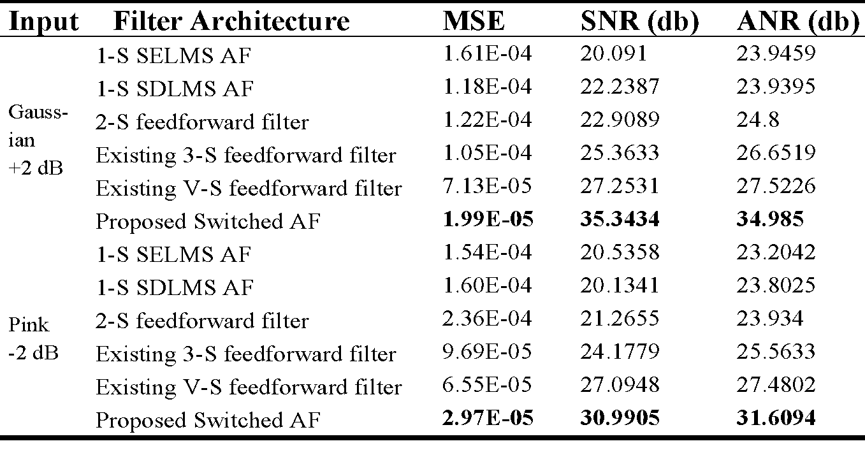
Results
Table 1. MSE, SNR and ANR for different AF structures: Normal PCG

Slide 17
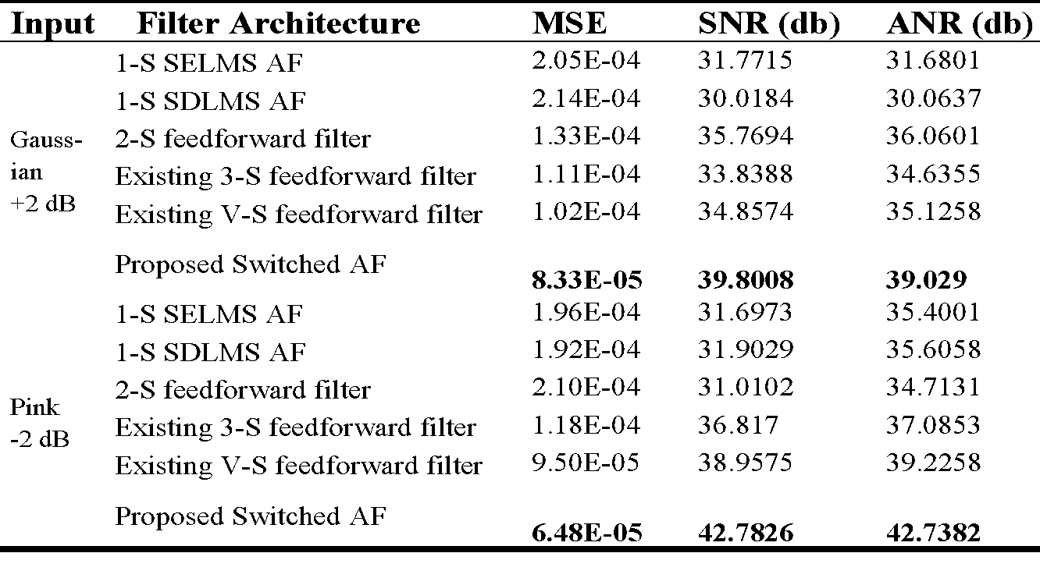
Results
Table 2. MSE, SNR and ANR for different AF structures: Pathological PCG

Slide 18

Time & Action Plan (Gantt Chart)
Minor Project Timeline (B145)

Slide 19
References
1. H. Deng and M. Doroslovacki, "A New Adaptive Noise Cancellation Scheme for Speech Enhancement," IEEE Transactions on Signal Processing, vol. 53, no. 7, pp. 2341-2351, July 2005, doi: 10.1109/TSP.2004.831255.
2. Yang Liu, A Noise Reduction Method Based on LMS Adaptive Filter of Audio Signals, 3rd International Conference on Multimedia Technology, ICMT, 2013.
3. S. Shahidi and M. Mirzaei, "Performance Analysis of Adaptive Filters for Noise Cancellation in Various Environments," IEEE Transactions on Signal Processing, vol. 54, no. 8, pp. 2952-2962, Aug. 2006, doi: 10.1109/TSP.2006.870888

